Slide 1
Albatana
Group ID : BCA2306
Abdelhakim Elshaikh 2020-B-01012001
Alan Angre 2020-B-25022002
Guided By: Mr. Chandan Prasad

Slide 2
Contents
Introduction
Motivation
Literature Survey
  Taxonomy Chart
  Existing System Architecture
Problem Definition
Albatana
  Albatana System Architecture
  Albatana Implementation
Conclusion & Future Scope
References

Slide 3

Introduction
Introduction of Ecommerce
  B2B
  B2C
Introduction of Albatana

Slide 4
Motivation
  Business Enhancement
  Sponsored
  Live Project
  Skill Enhancement
  Team Work

Slide 5
Literature Survey
  Ecommerce based on Cloud Computing
  Future of E-commerce in India
  A Review Paper on E-commerce
  Big Data analytics in E-commerce: a systematic review and agenda for future research
  Factors Affecting Consumer’s purchasing Decision through E-commerce
  An Overview of Electronic Commerce (e-Commerce)
  What Drives Consumers to Shop Online
  Understanding Repurchase Intention in Online Fashion Shopping mall
  E-Commerce: A Study on Online Shopping in Malaysia
  Electronic Commerce: A Study on Benefits and Challenges in an Emerging Economy

Slide 6
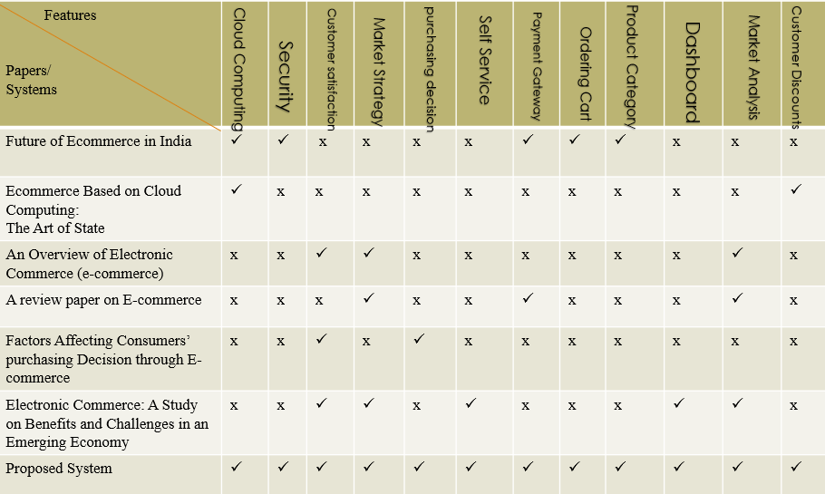
Literature Survey Cont..
  Taxonomy Chart

Slide 7
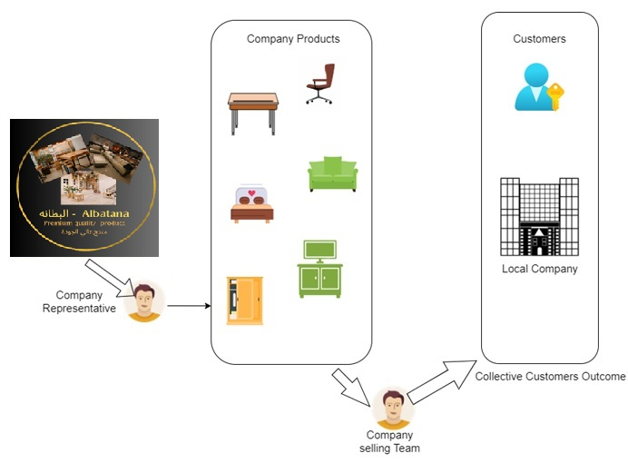
Literature Survey Cont..
  Existing System Architecture

Slide 8
Problem Definition
The website created will help shift business of Albatana Furniture Store from a physical furniture environment to an online ecommerce shopping experience. The website helps the developer to develop project for independent business called Albatana.
Albatana is a furniture store website that once created will help users find Furniture items on display online to view, and buy all products digitally and make shopping easier and simplified.
An e-commerce website serves as a platform where individuals can engage in the buying and selling of physical goods, services, and digital products online, eliminating the need for a physical store. By utilizing an e-commerce website, businesses can efficiently handle order processing, payment acceptance, shipping and logistics management, and customer service.

Slide 9
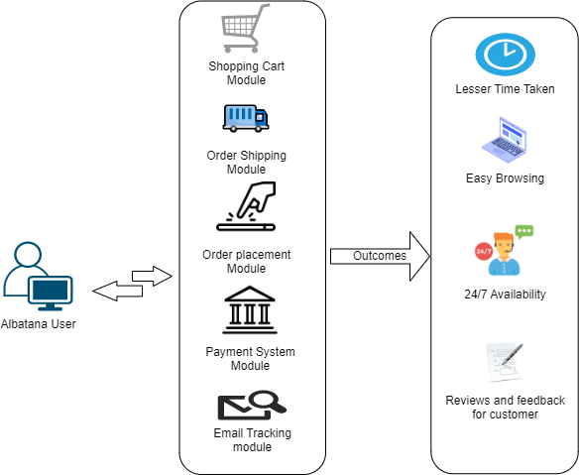
Albatana
  Albatana System Architecture

Slide 10
Albatana
  Albatana System Implementation

Slide 11
Conclusion & Future Scope
Albatana is a furniture store website will help users find Furniture items on display online to view, and buy all digitally and make shopping easier and simplified.
The website contain Furniture for all uses like Kitchenware, Dining, Office, Bedroom Furniture and Home Furniture. It will display all sizes and different colours, shapes and design all available on the website with models and pictures of each furniture. Users can create accounts to search and buy and also add payments details to later purchase these products.
The website functionality in frontend will have UI development for the User interface available to the end user. Technologies like HTML, CSS, JS, PHP, SQL, Servers, API and cloud Computing will be used to make the website full functional and a full stack developed website in both frontend and backend aspects.
The website will work like an ecommerce website designed for shopping, viewing and buying and also getting an easy access to furniture catalogue of the organization.

Slide 12
References
Future of E-commerce in India - Dr. Urvashi Sharma (2016)
A Review Paper on E-commerce -Arul V (2019)
Ecommerce based on Cloud Computing - Mayasim A. Abdulkadim Altemimi and Abbas H. Hassin Alasadi (2017
Big Data analytics in E-commerce: a systematic review and agenda for future research - Shahriar Akter Samuel Fosso Wamba (2016)
Factors Affecting Consumer’s purchasing Decision through E-commerce - R.R.K Sharma (2016)
An Overview of Electronic Commerce (e-Commerce) - Vipin Jain, Bindoo Maviya, Satyenda Arya (2021)
What Drives Consumers to Shop Online - Khushboo Makwana (2016)
Understanding Repurchase Intention in Online Fashion Shopping mall - Han-Na Kim1 and Kwan-Sik Na2 (2015)
E-Commerce: A Study on Online Shopping in Malaysia - Adeline Chua Phaik Harn, Ali. Khatibi and Hishammuddin bin Ismail (2006)
Electronic Commerce: A Study on Benefits and Challenges in an Emerging Economy -Abdul Gaffar Khan (2016)
A comprehensive review on e-commerce research - Vivian Khoo (2018)
joint statement initiative on E-commerce (JSI): Economic and Fiscal Implications for the South - Rashmi Banga (2021)
THE CONSISTENCY OF TRUST-SALES RELATIONSHIP IN LATINAMERICAN E-COMMERCE-Juan C. Correa(2021)
impact of social media on e-commerce - Arunakshi Pratap Singh (2021)
E-commerce: Concept and Legal regulation in Modern Economic Conditions - Aleksy Kwilinski (2019)

